Slide 1
Supporting my child’s independent Learning
As you know, whilst the school is closed its important to continue to support your child’s learning from home. As well as the packs already provided for students on office 365 by individual subject areas please find attached a powerpoint with some tips and links to further information that will be useful now and in the future to help your child build the independent learning skills essential for creating deep, embedded knowledge.
These principles are not only useful during the school closure but will support your child throughout their whole education. If you have any questions about how to further support your child’s independent learning please contact Mr Ramsland via email on bramsland@dwhs.co.uk

Slide 8

2. Interleaving
Instead of practicing one skill at a time (“AAABBBCCC”), interleaving mixes practice on several related skills together (for example, “ABCABCABC”).
switch between ideas during a study session
go back over the ideas again in different orders

Slide 9
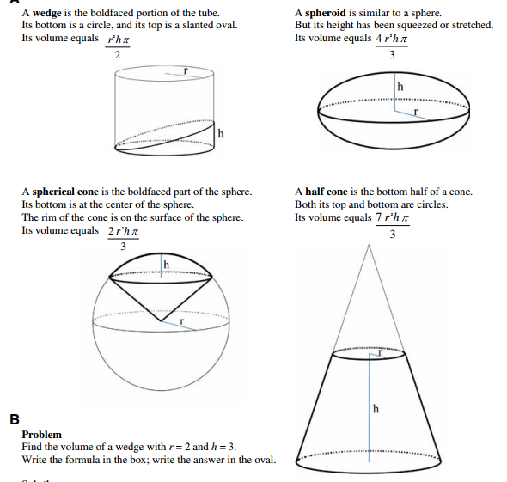
2. Interleaving: evidence
maths problems
Mixer: A B C D, D B A C …
Blocker: A A A A, B B B B …
Rohrer & Kelli (2007). Instr Science

Slide 10
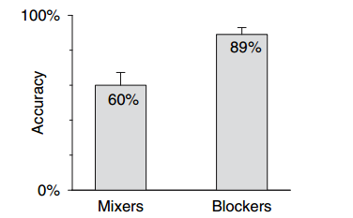
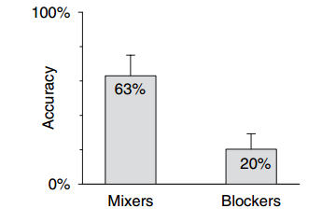
2. Interleaving: evidence
practice session performance
test session performance
Mixer: A B C D, D B A D …
Blocker: A A A A, B B B B …
Rohrer & Kelli (2007). Instr Science

Slide 11

3. Retrieval Practice
Devote some of the learning period to retrieving the to-be-remembered information through testing it with proper feedback.
answering questions is strengthening memory
active learning > passive learning

Slide 12
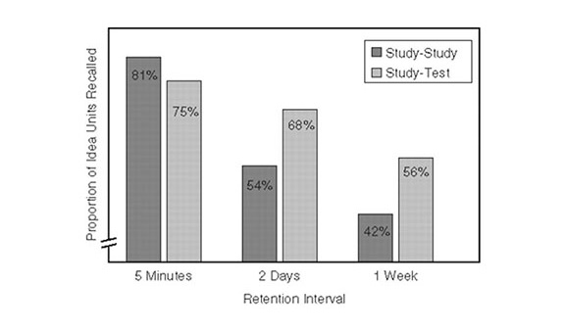
3. Retrieval Practice: evidence
Roediger & Karpicke (2006). Perspectives on Psychological Science

Slide 13

4. Sleep
Diekelmann & Born. (2010). Nature Review

Slide 14
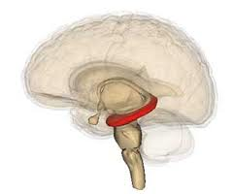
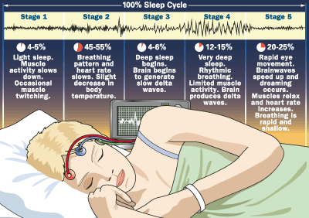
4. Sleep: evidence
What is happening when we sleep?
The hippocampus is refreshing the information from the day thereby strengthening representations elsewhere in the brain – i.e. consolidations

Slide 25
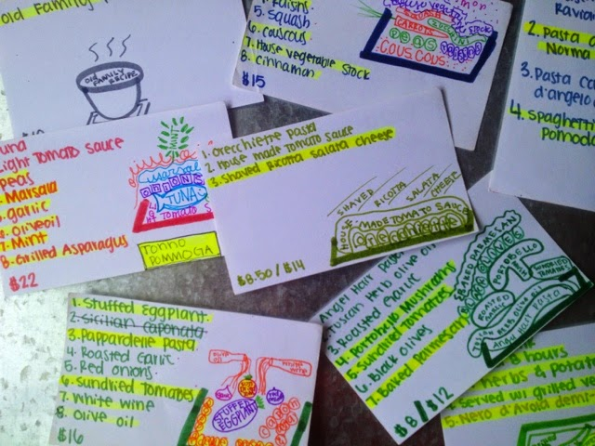
Flash cards: Top tips
Keep information small and simple: avoid false positives. 1 question or term per card.
Mix pictures/words picture: picture superiority effect
https://www.youtube.com/watch?v=mzCEJVtED0U

Slide 26
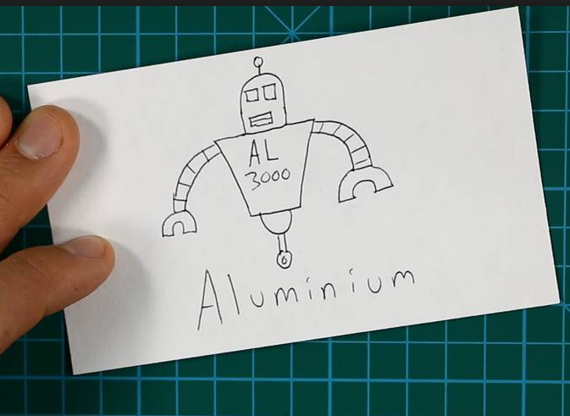
On one side write the fact you’re trying to learn.
For example for English you may want to learn the quote “Out damned spot.” You may do a drawing that will make the card more memorable.
On the reverse write your question.
e.g. “What quote demonstrates Lady Macbeth’s guilt is leading her towards insanity”
Flash cards: Top tips

Slide 27

Flash cards: Your turn
Create flashcards for these 5 facts you’ve learnt in the last week.

Slide 28
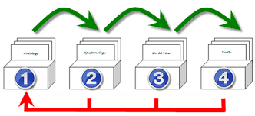
Flash cards: Top tips
Use spaced revision strategies. Leitner box.

Slide 35
Step 1 - FIGURE OUT HOW much time you have to revise
Are you currently on school holidays and have a set period of time available time before you go back to school?
Is it term time but you want to get some revision done before and after school?
Do you have an exam timetable which you can use to pace your revision against for each subject?
Whatever category you find yourself in, set a clear deadline so you have something to work towards.

Slide 36
STEP 2 - PRIORITISE YOUR SUBJECTS/TOPICS
The next step requires some introspection. You need to decide which subjects you currently feel the most and least confident about.
The best way to do this is to make a list. Write the subjects you’re weakest at towards the top and those where you’re strongest towards the bottom. Give each of them a number as a reminder for when you input them into your timetable. See the screen shot on the next slide for an example including GCSE subjects. If you’re studying only one or two subjects do this same exercise for each of the modules or topics within those subjects.

Slide 37
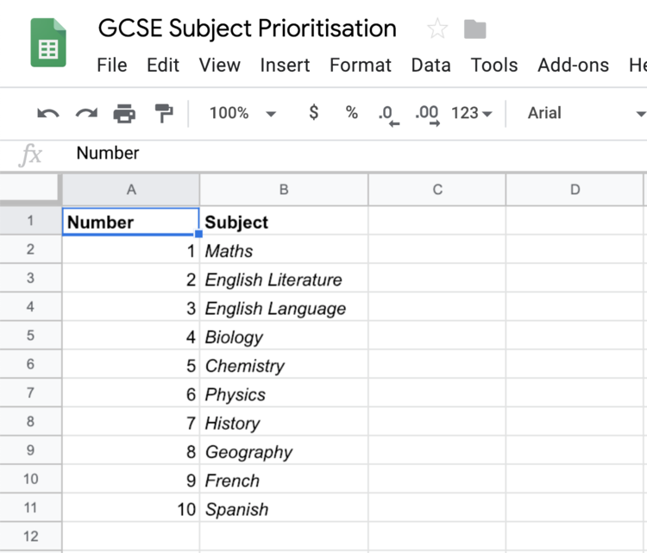
STEP 2 - PRIORITISE YOUR SUBJECTS/TOPICS
When you’re making this list take into account a couple of other factors such as:
The amount of material to be learned within each subject.
Mark weightings within subjects.
The order of your exam timetable (if you have it already). You’re going to have more time to revise some subjects than others based on where they are positioned within your exam timetable.
What your grades currently look like – for example, if your Physics grade is rock bottom, you might want to prioritise it above the English Literature class you’ve already got 60% in through nailing the coursework (if applicable).

Slide 38
Step 3 - Break Subjects into topics
"Our brain tricks us into believing the low-hanging fruit really is the ripest". Conversely, when one option is harder to get, we’re more likely to think it’s the wrong choice.
This metaphor helps explain how we, and many other things in the world, naturally take the path of least resistance and post rationalising.
This is why you need to be fully aware of what you don’t know and consciously choose to meet those challenges head on. Feel the urge to bail out and take the easy route, but resist it.
Spend most time on the topics where you are less strong.

Slide 39
Step 4 - allocate 30 minute time slots to revise
Allocate 30 minute time slots to study each topic. Here’s the workflow you need to follow when scheduling your sessions:
Position topics you’re likely to find challenging when you know you tend to work best in the day.
Find a balance between topics you’re less familiar with and those which you think you’ll be able to get through quickly. Use the list you created in Step 2. This will keep a nice balance between revision being a challenge and you making good progress.
Leave a few time slots blank towards the end of the day for some rapid reviews and testing.

Slide 40
Why 30 minutes?
The reason for this time frame is it breaks the day up more so we have the chance to vary what we’re revising in each session. There are three benefits to this:
Revision becomes less monotonous and slightly more interesting.
Time distortion: smaller chunks of time add the helpful illusion that we’re doing more, this sense of progress can help build positive momentum.
Interleaved practice: cognitive psychologists believe that by varying what we study regularly stronger distinctions and memory associations will be formed between each set of information.
A time goal: it provides a time goal for each session so we are held more accountable to actually revising the topic when we’re at our desk, not day dreaming for some of the time and using the time we’ve studied for as the vanity metric for success which makes us think we know more than we do.

Slide 41
Step 5 - What to do within each revision session
Step 5 is crucial because it ensures you not only understand the information but can remember and recall it too.
Your initial revision sessions are going to involve you taking bullet pointed notes on what you need to learn on A4 sheets of paper and then condensing these bullet points on to flashcards which you can use to test yourself.
Regular testing and repetition are the key components to long term understanding and memorisation for exam day. Studies conducted by psychologists and education specialists have termed ACTIVE RECALL and SPACED REPETITION as two of the most effective revision principles which can be used to help students understand and memorise information for their exams.

Slide 42
Step 6 - Stay Flexible
It’s ok if you find things slow going to begin with or you can’t get into a good working rhythm. You will build some momentum eventually if you persist.
The key is to keep the discipline of revising when you said you were going to on your timetable and aim for a short burst of 30 minutes. Then push on if you’re feeling the momentum. If not, take a short break (5-10 minutes) and then hit the books again. Start with some easier information to get yourself going in each session if you need to.
As time goes by, make adjustments to your timetable to cover information you’re still not totally clear on.

Slide 43
Step 7 – Make your timetable achievable
Make your timetable achievable by managing your health and stress levels and by allocating time to exercise, socialise and generally forget about revision for a bit. Revision requires high levels of:
Self awareness
Discipline
Adaptability
Organisation
As much as exams are testing you about what you know in each subject, they’re also testing you for these 4 skills, all of which are critical to your development later in life.
Finally, refer to your timetable often so you can gut-check how your pacing, some days you're going to have to work faster and longer than usual, others you can afford to ease off a bit. It’s up to you to make that judgement call.

Slide 44
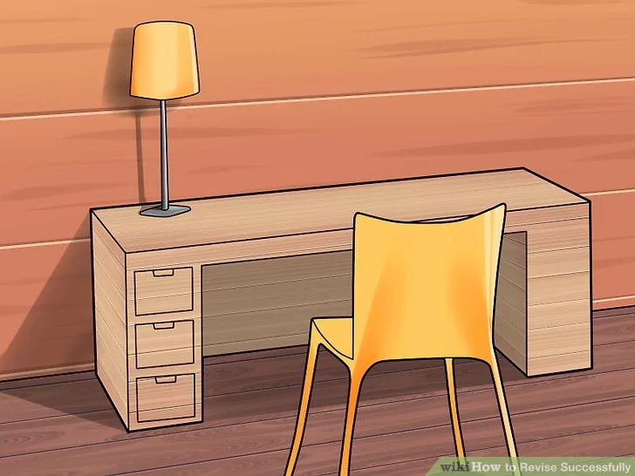
How to Revise: Organising your revision
Somewhere quiet
No distractions (social media off)
Different locations for different subjects?
Study in public?

Slide 45
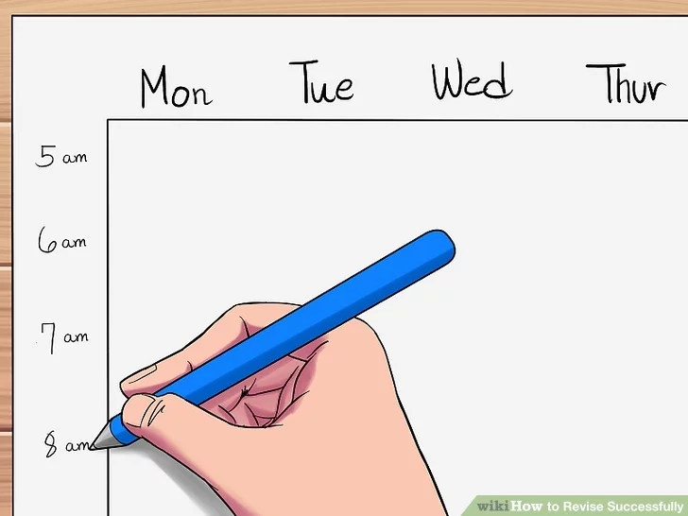
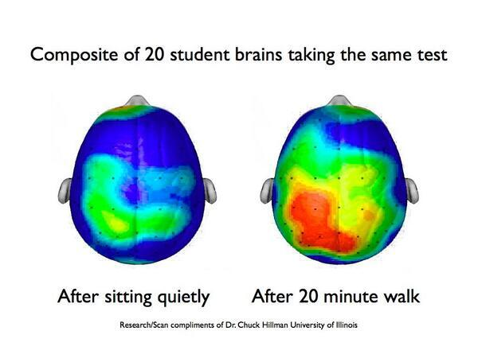
How to Revise: Organising your revision
Not a work of art
Build in breaks
Mix up the subjects

Slide 46
“Its okay, I’ve been reading my revision guide”
• Passively reading through your notes and books is a very poor method of revision.
• It doesn’t help you to understand or remember what you are revising.
• Don’t just sit there reading page after page until you get bored.

Slide 47
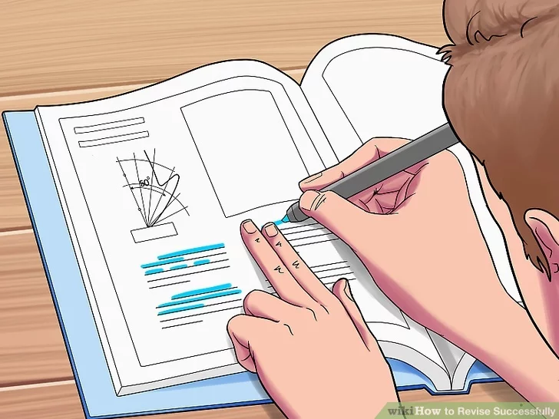
How to Revise: Active revision
Engage with your texts Mind maps
Test yourself Flash cards
Teach a friend/family member
Study Guides Practice Papers

Slide 48
Flash cards: Top tips
Keep information small and simple: avoid false positives.
Mix pictures/words picture: picture superiority effect
Use spaced revision strategies. Leitner box.

Slide 49
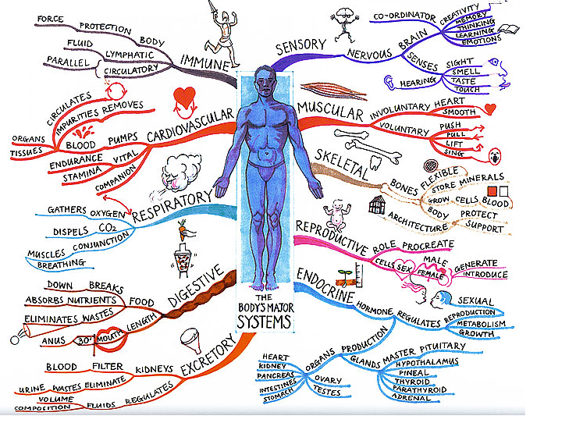
Mind Maps: Top tips
Useful for organising complex/monotonous information into a colourful, memorable and highly organised diagram that works in line with your brain's natural way of linking information.
It helps your brain connect the information (see the theory).
Use colour and images to help the brain make links and aid memory in the assessment.

