Slide 1
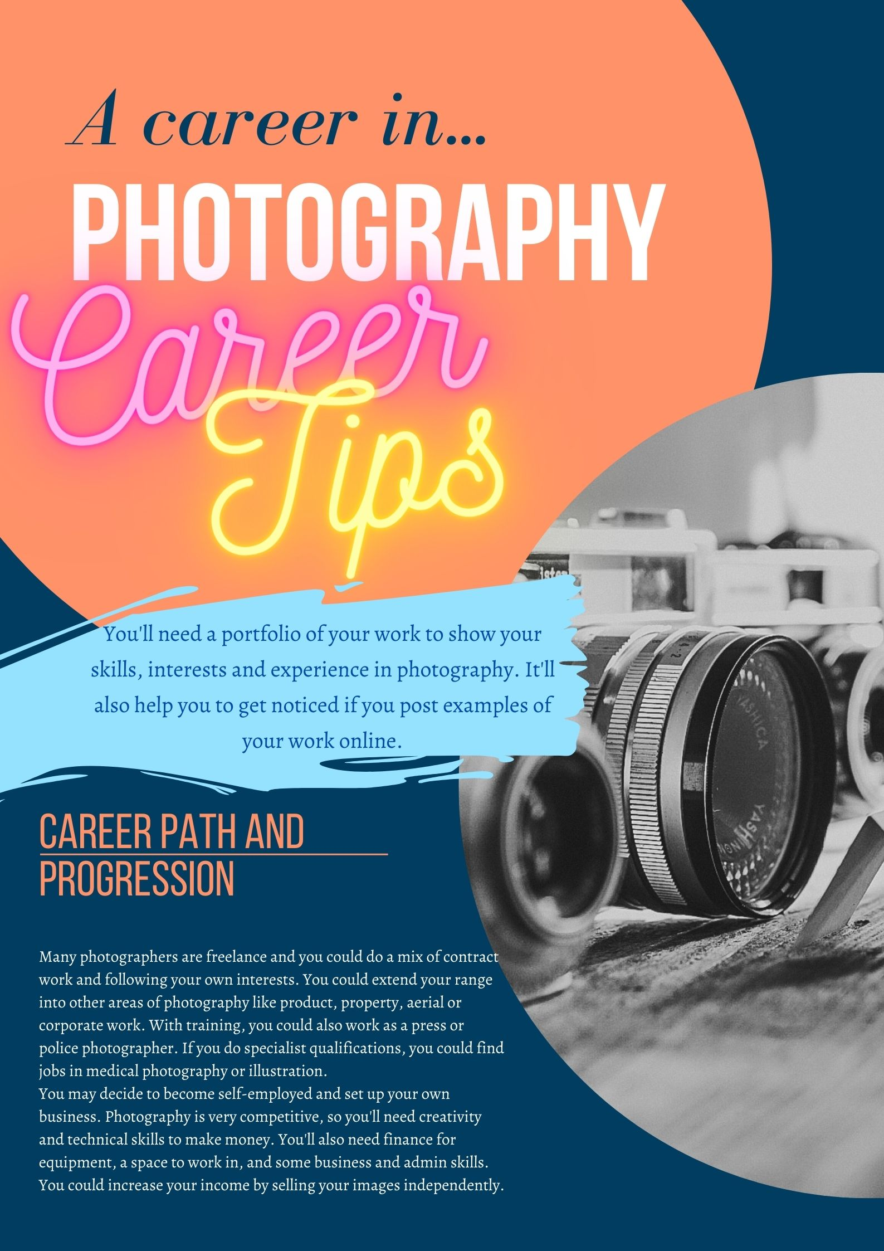
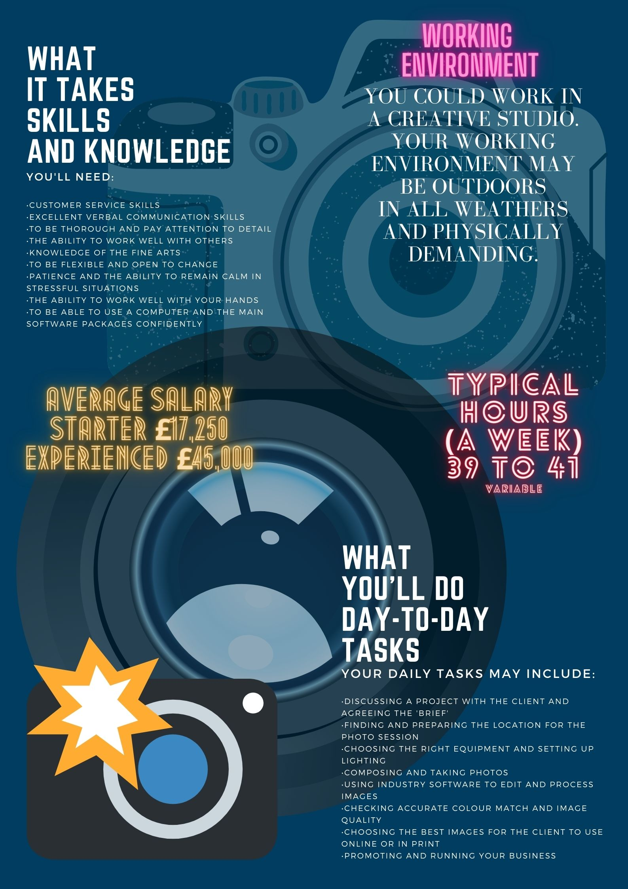

Slide 2

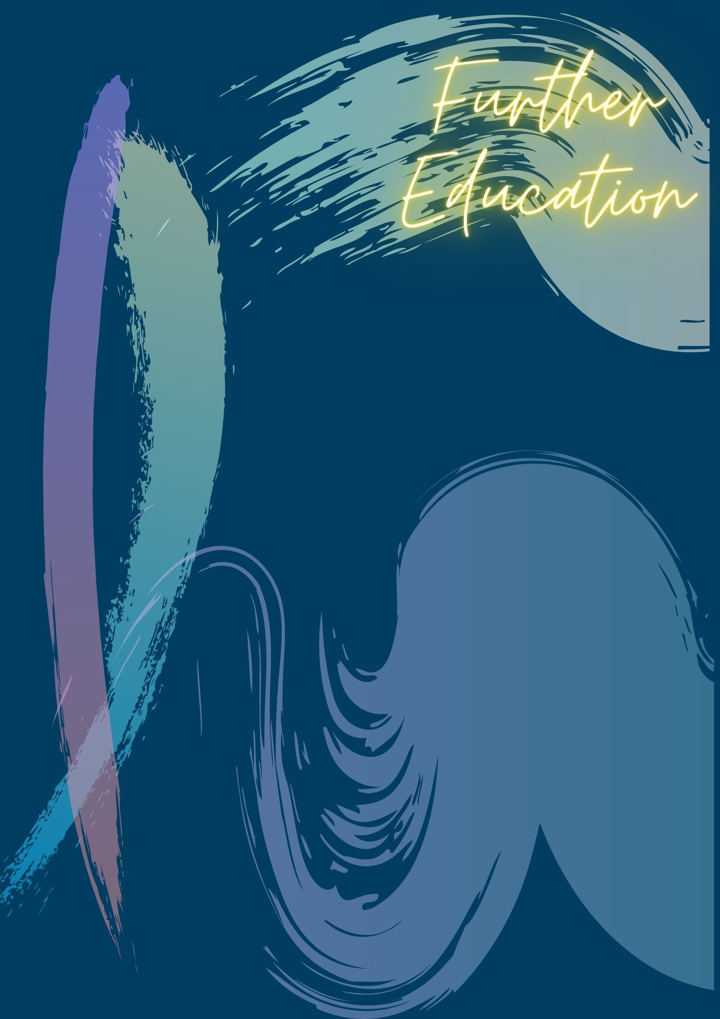
University
You could do a foundation degree, higher national diploma or degree in:
Photography
Visual Arts
Commercial Photography
Fashion Photography
Art and Design
Video and Digital Imaging
Photojournalism
Lighting Design
Entry requirements
You'll usually need:
1 or 2 A levels, or equivalent, for a foundation degree or higher national diploma
2 to 3 A levels, or equivalent, for a degree
Further information
You can find out more about becoming a photographer through the British Institute of Professional Photography.
View information on courses, careers, bursaries and competitions on the Royal Photographic Societies website
Learn about photography and keep up to date with contemporary photography and exhibitions at The Photographers’ Gallery, The Tate Modern, The National Portrait Gallery and The V & A Photography Centre.
You can get more details on working in creative careers from Discover Creative Careers.
College
You could take a Level 3 Diploma in Photography, which may help you to find a job as a photographer's assistant in a studio.
Entry requirements
You'll usually need:
4 or 5 GCSEs at grades 9 to 4 (A* to C), or equivalent, including English, maths and a creative subject
Click on the links to connect to more info.
Apprenticeship
You could complete an advanced apprenticeship in photo imaging or creative and digital media.
Entry requirements
You'll usually need:
5 GCSEs at grades 9 to 4 (A* to C), or equivalent, including English and maths, for an advanced apprenticeship
Professional and industry bodies
The Association of Photographers offers membership for anyone with an interest in professional photography.
You can also apply to join the British Institute of Professional Photography.
Work
You could start as a photographer's assistant and work your way up. It's usual to specialise in one kind of photography, like fashion, advertising, wildlife or photojournalism.

Slide 3
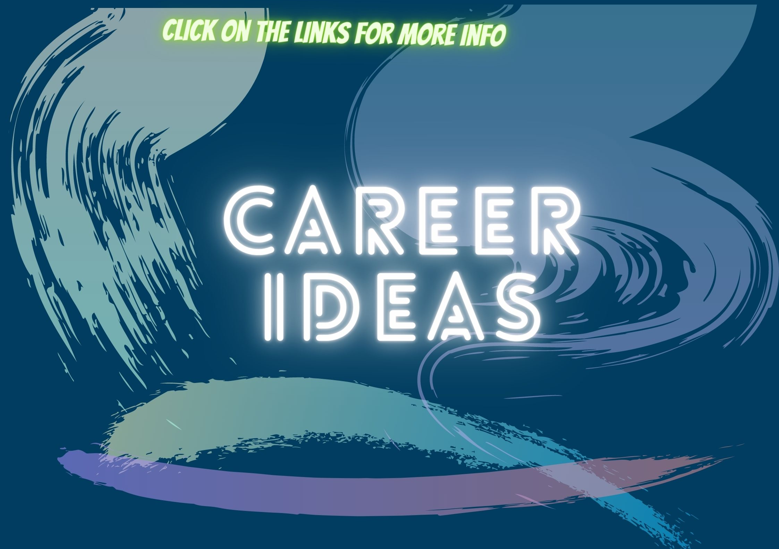
Assisting Photographer
Director of Photography
Lighting Technician
Graphic Designer
Medical Illustrator
Lighting Artist
Creative Director
Photographic Stylist
Photographer
Drone Pilot
Photographer’s Agent
Art Curator
Art editor
Photographic stylist
Forensic Photographer
Animator
Compositor
Press Photographer

Slide 4

Click this link to watch a video on careers in creative industries
https://creativejourneyuk.com/

