Slide 1
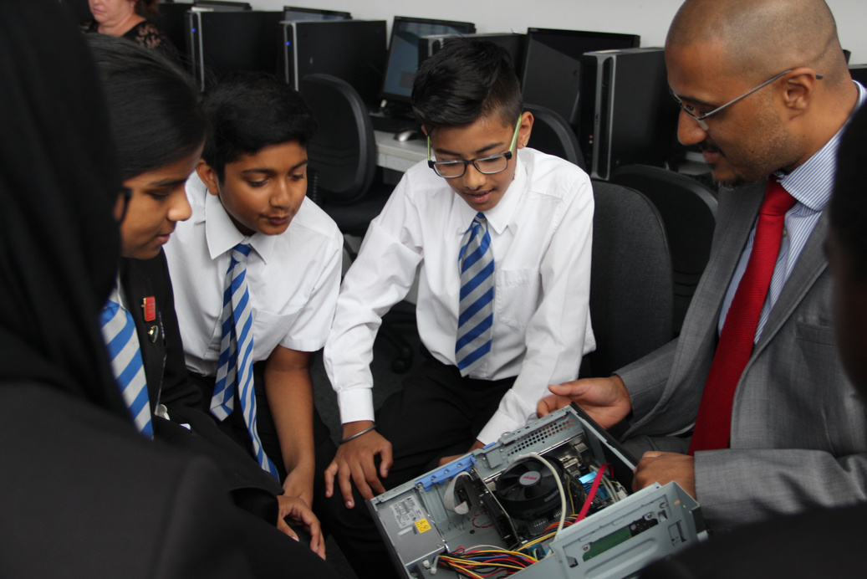
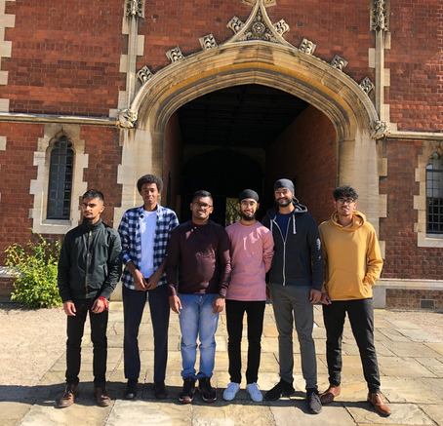
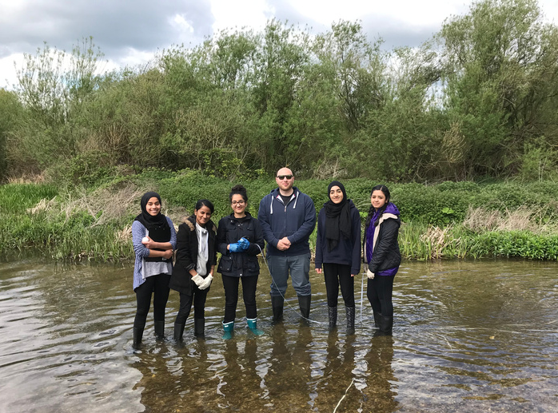
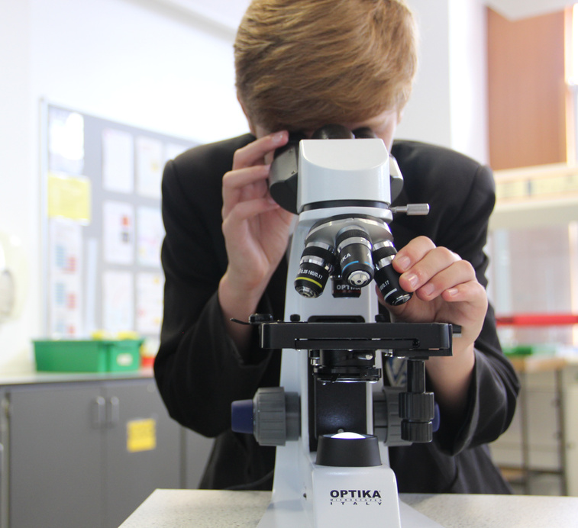
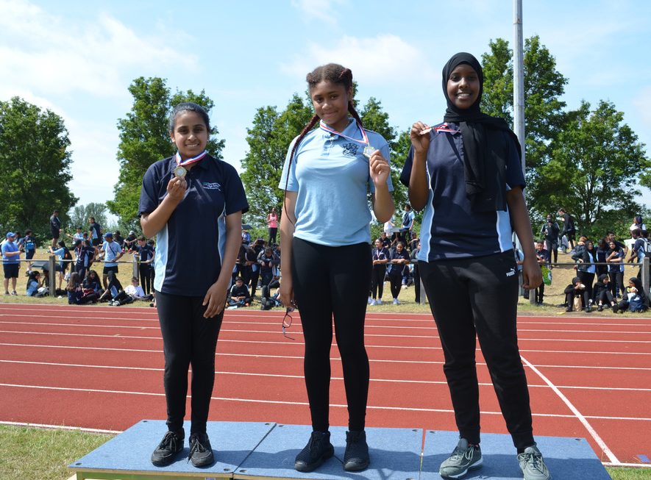
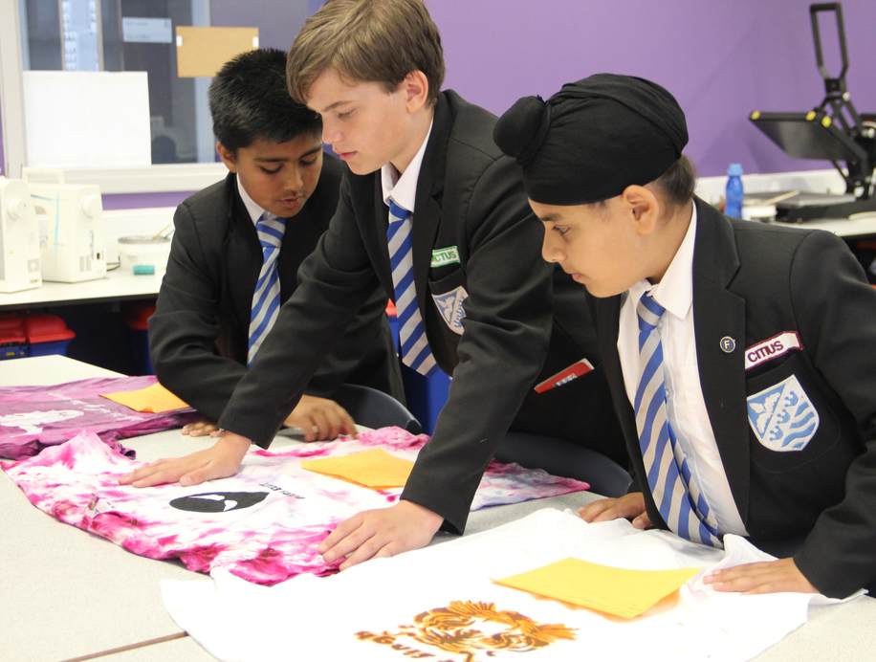
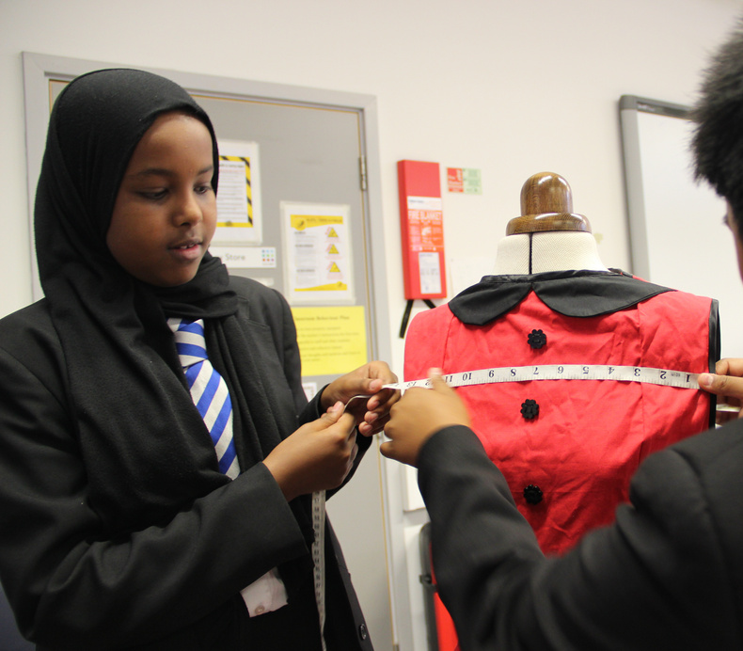
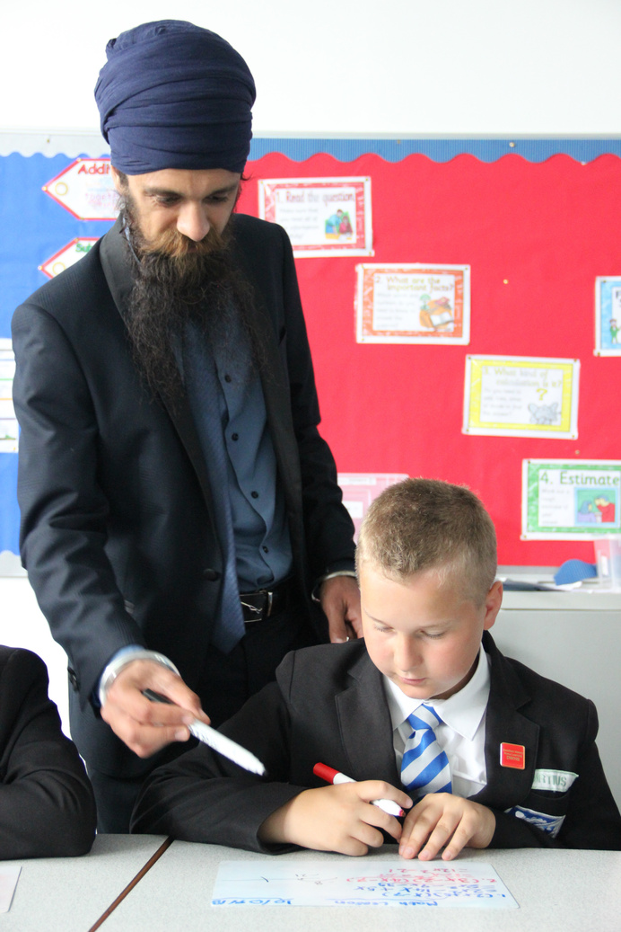
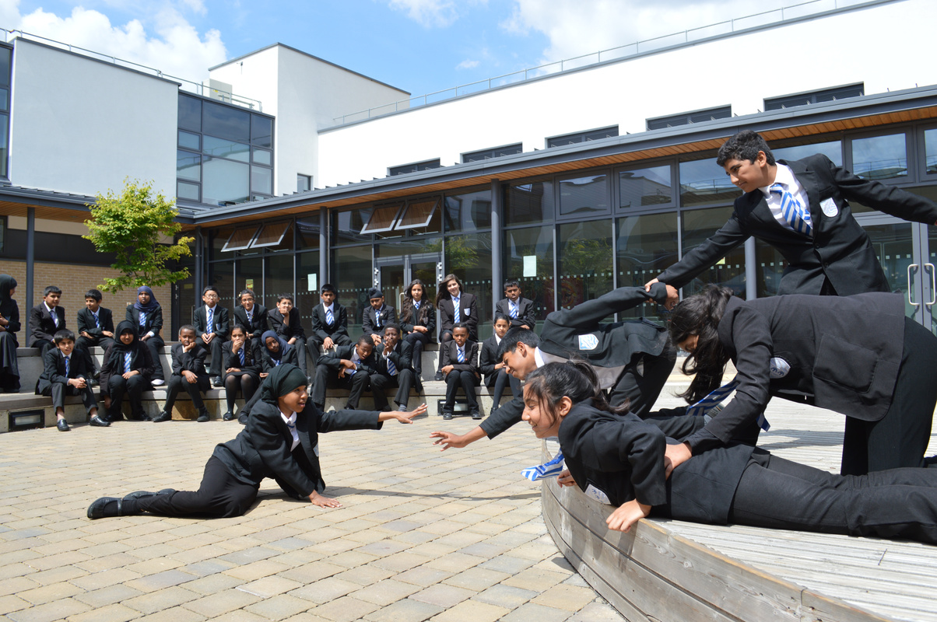
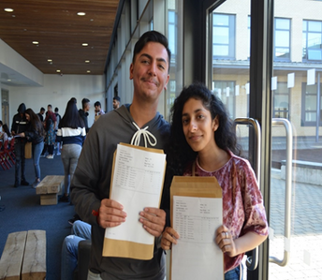
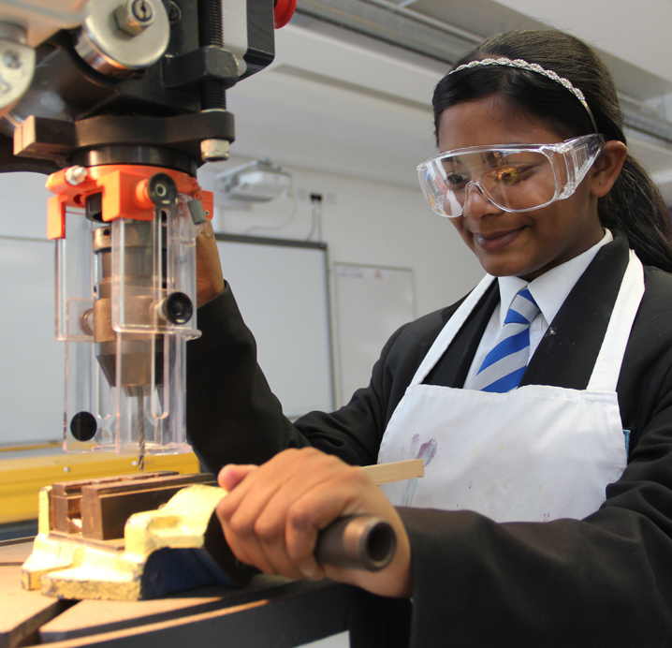
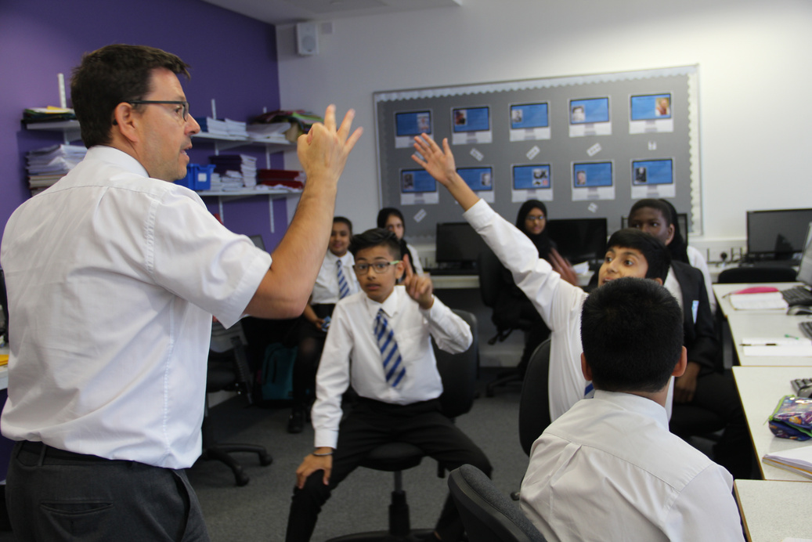
YEAR 9
OPTIONS EVENING

Slide 2
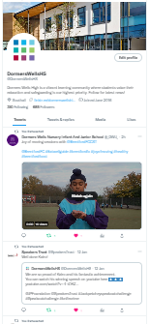
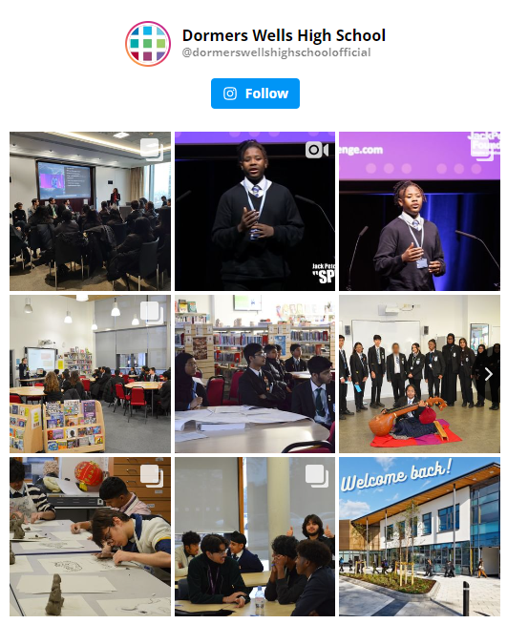
WELCOME TO YEAR 9 OPTIONS EVENING
Headteacher - Ms Walsh
​​ www.dwhs.co.uk ​
@DormersWellsHS
@CareersDWHS1 ​
@DormersWellsHigh SchoolOfficial

Slide 3
YEAR 10 OPTIONS
Options are a key milestone in each child's education.​
Students will take some control over what they study.​
Students are making choices which will affect their future.

Slide 4
YEAR 10 OPTIONS EVENING
To support your child in making an informed choice for KS4​.
​To provide you with further information on how best to support your child through the options process and selecting their subjects for Years 10 & 11.​​
To understand the process required to accurately express their preferred subject selection at KS4​.

Slide 5
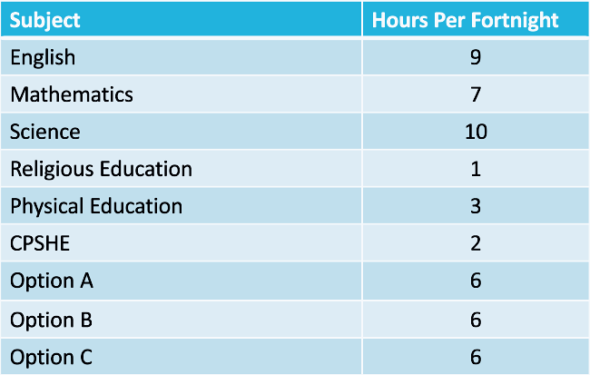
CURRICULUM TIME

Slide 6
CHOOSING YOUR SUBJECTS
POSITIVE
I’m good at the subject​
I enjoy the lessons​
I know what it will involve in the future​
It will help me when I’m older​

Slide 7
CHOOSING YOUR SUBJECTS
NEGATIVE
My friend is choosing the subject​
I like the teacher who is teaching me now​
It’s a new subject so I think that I’ll like it​
Other people want me to do the subject​

Slide 8
STUDENT MEETINGS​
All year 9 students will have an individual appointment with a senior member of staff.​​
​
These will take place on March 4th or 6th.
The appointment details were sent home via the letter inviting you to our options evening.

Slide 9
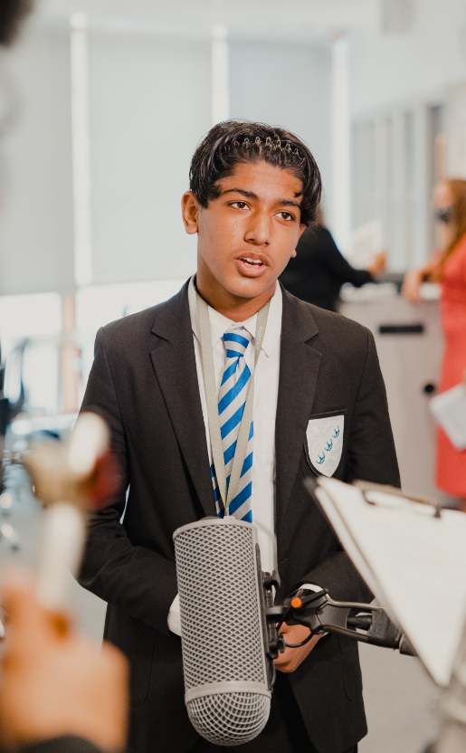
EBACC QUALIFICATIONS​
English
Mathematics
Science
Geography or History
French or Spanish​​
Most students will be expected to continue with a language and humanities subject into Year 10.​

Slide 10
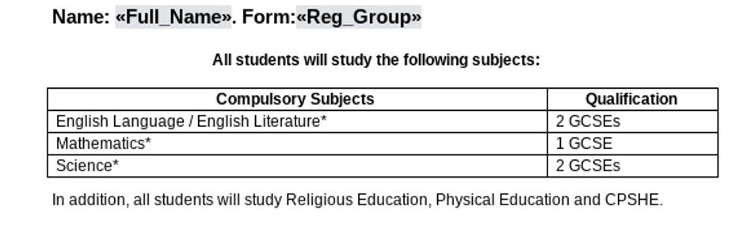
YEAR 9 INTO 10 OPTION FORM

Slide 11
YEAR 9 INTO 10 OPTION FORM
Subject choices​
French*
​Spanish*
​Geography*
​History*​
Computer Science*​

Slide 12
YEAR 9 INTO 10 OPTION FORM
Options that you currently study​
New options that you can study​
Art & Design​
Computer Science*​
Design and Technology​
Drama (Performing Arts)​
Food and Nutrition ​
French*
​Geography*​
History*​​
Physical Education
​Religious Studies ​
Spanish*​
Business Studies
​Citizenship​
​Health and Social Care (BTEC)
​Sociology​
Sport (BTEC)​
Photography

Slide 13
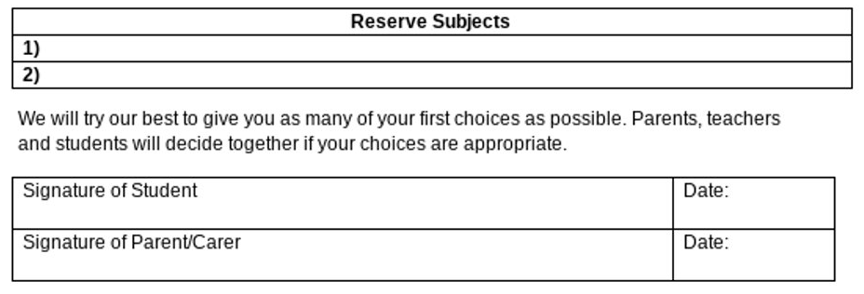
YEAR 9 INTO 10 OPTION FORM
YOU MUST SUBMIT YOUR FINAL CHOICES AT YOUR IAG INTERVIEW IN MARCH​​

Slide 14
OPTIONS PROCESS
Sessions in form time discussing careers and education choices
Meeting with a member of the Leadership Team / Year Team in March.​​
You must submit your final choices at your IAG interview in March
​​
Subjects are put into options blocks
​​A further meeting is arranged with any students who do not have all their first choices.​​
Students/parents are informed of the final choices

